Slide 1

2-person Stackelberg pricing games
Group 36
Bushuizhang , Weilue luo, Yecheng chu, Zhaoyu zhang

Slide 2


Analyze the behavior of the three followers
Modify SimpleLeader.java
Set the leader price to be date
Plot for follower price against leader price
Linear or Non-Linear

Slide 3
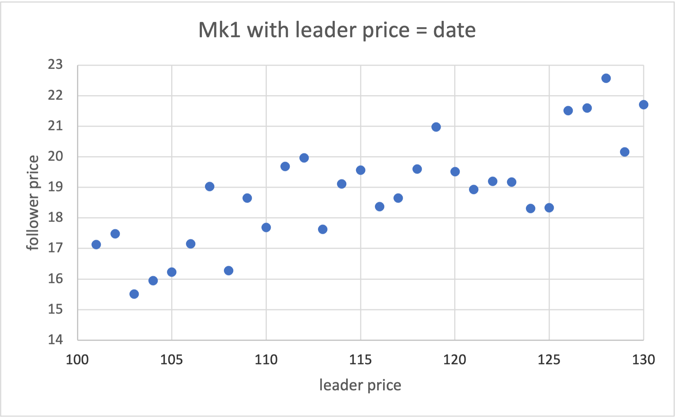
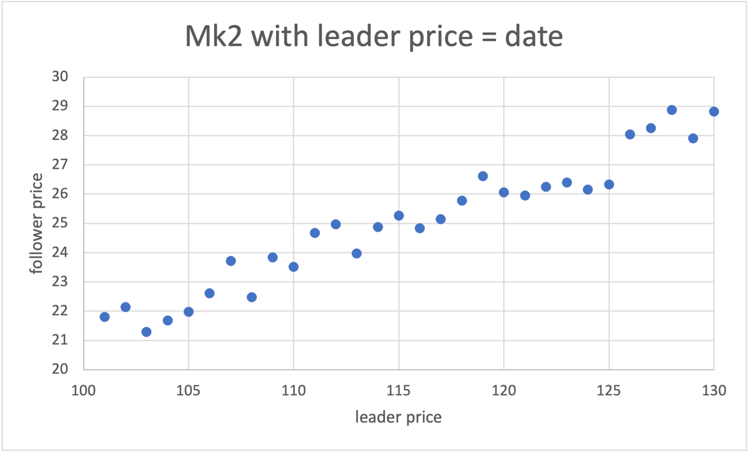

Mk1 and Mk2 are both linear

Slide 4
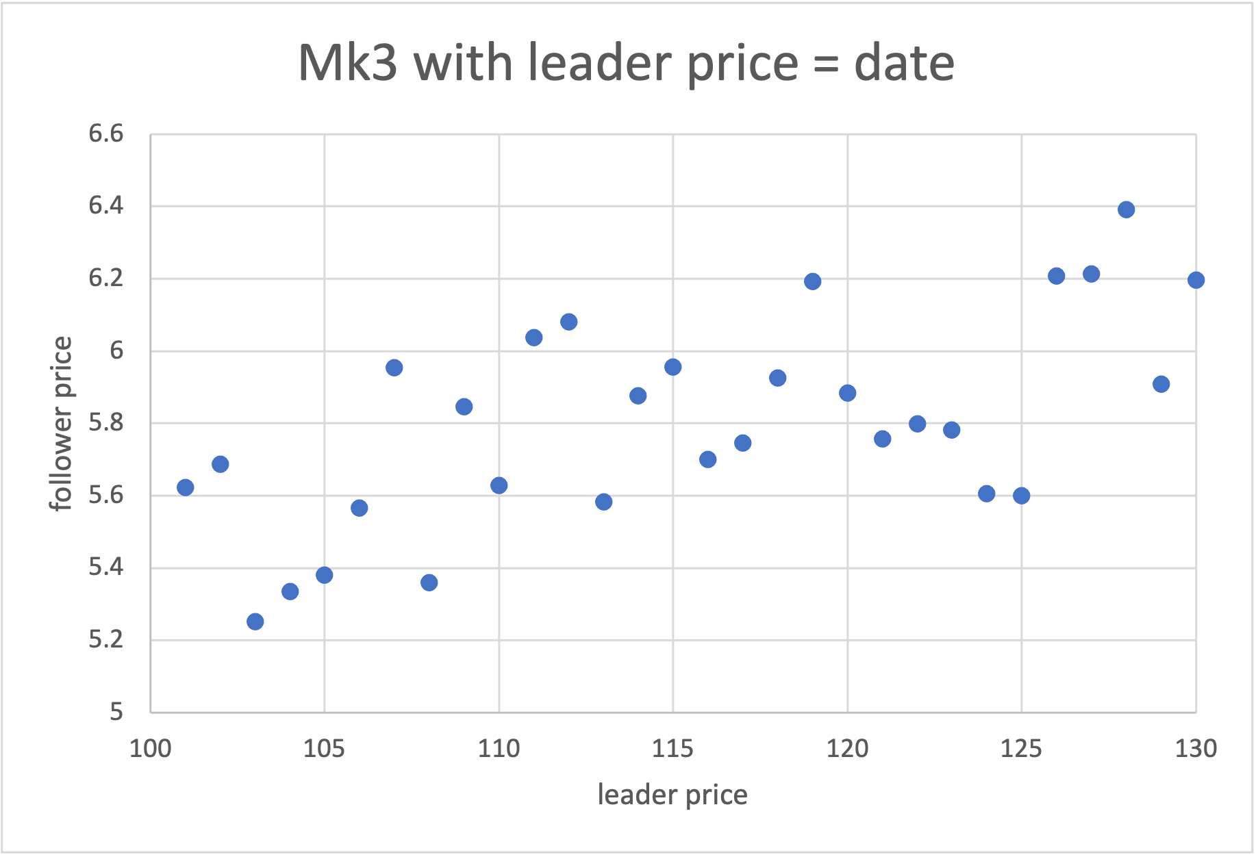

Mk3 could be non-linear

Slide 5

Linear Approaches
All historical Data
Moving window
Modified moving window
Weighted Least square with forgetting factor
Goal: find the follower reaction function

Slide 6




Best leader strategy given follower reaction
Given follower reaction
Substitue into Leader profit equation
Group common terms
Make 1st derivative equal to zero and solve the leader price
(Referenced from Lecture03)

Slide 7

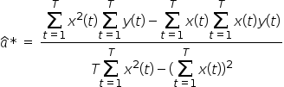
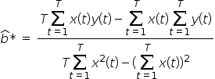
All Historical Data Approach
Use all the historical data to do the estimation
In the equation x(t) is the leader price at day t
And y(t) is the follower price at day t
Convert the minimization problem to maximization problem.
Set the 1st order partial derivative equal to 0 to solve this problem.
(Referenced from Lecture04 Slide16-20)

Slide 8

Moving Window Approach
Similar to All Historical Data Approach
Instead of looping through all the historical data
Use a window to loop only the recent data
For example: a window size of 30 will just loop the data of past 30 days
(Referenced from Lecture06 Slide 6-7)

Slide 9

Evaluation and Analysis
 | All historical data | Moving window Size = 100 | Modified moving window Size = 30 Lambda = 0.95 | Weighed least square with forgetting factor Lambda = 0.99 | ML | Best approach
Mk1 | 17.5571613311768 | 17.5557403564453 | 17.5533294677734 | 17.5550231933594 | 17.5550460815429 | All historical data
Mk2 | 16.9564590454102 | 16.9558563232422 | 16.9577598571777 | 16.9558162689209 | 16.9468994140625 | Modifeid moving window
Mk3 | 19.4882831573486 | 19.4883308410645 | 19.4879131317139 | 19.4882564544678 | 19.4883728027343 | ML
 | Analysis
Mk1 | Linear and not depend on date
Mk2 | Linear and depend on date
Mk3 | Non-linear

Slide 10

Thank you !
Group 36
Bushui zhang
Weilue luo
Yecheng chu
Zhaoyu zhang

